Slide 1



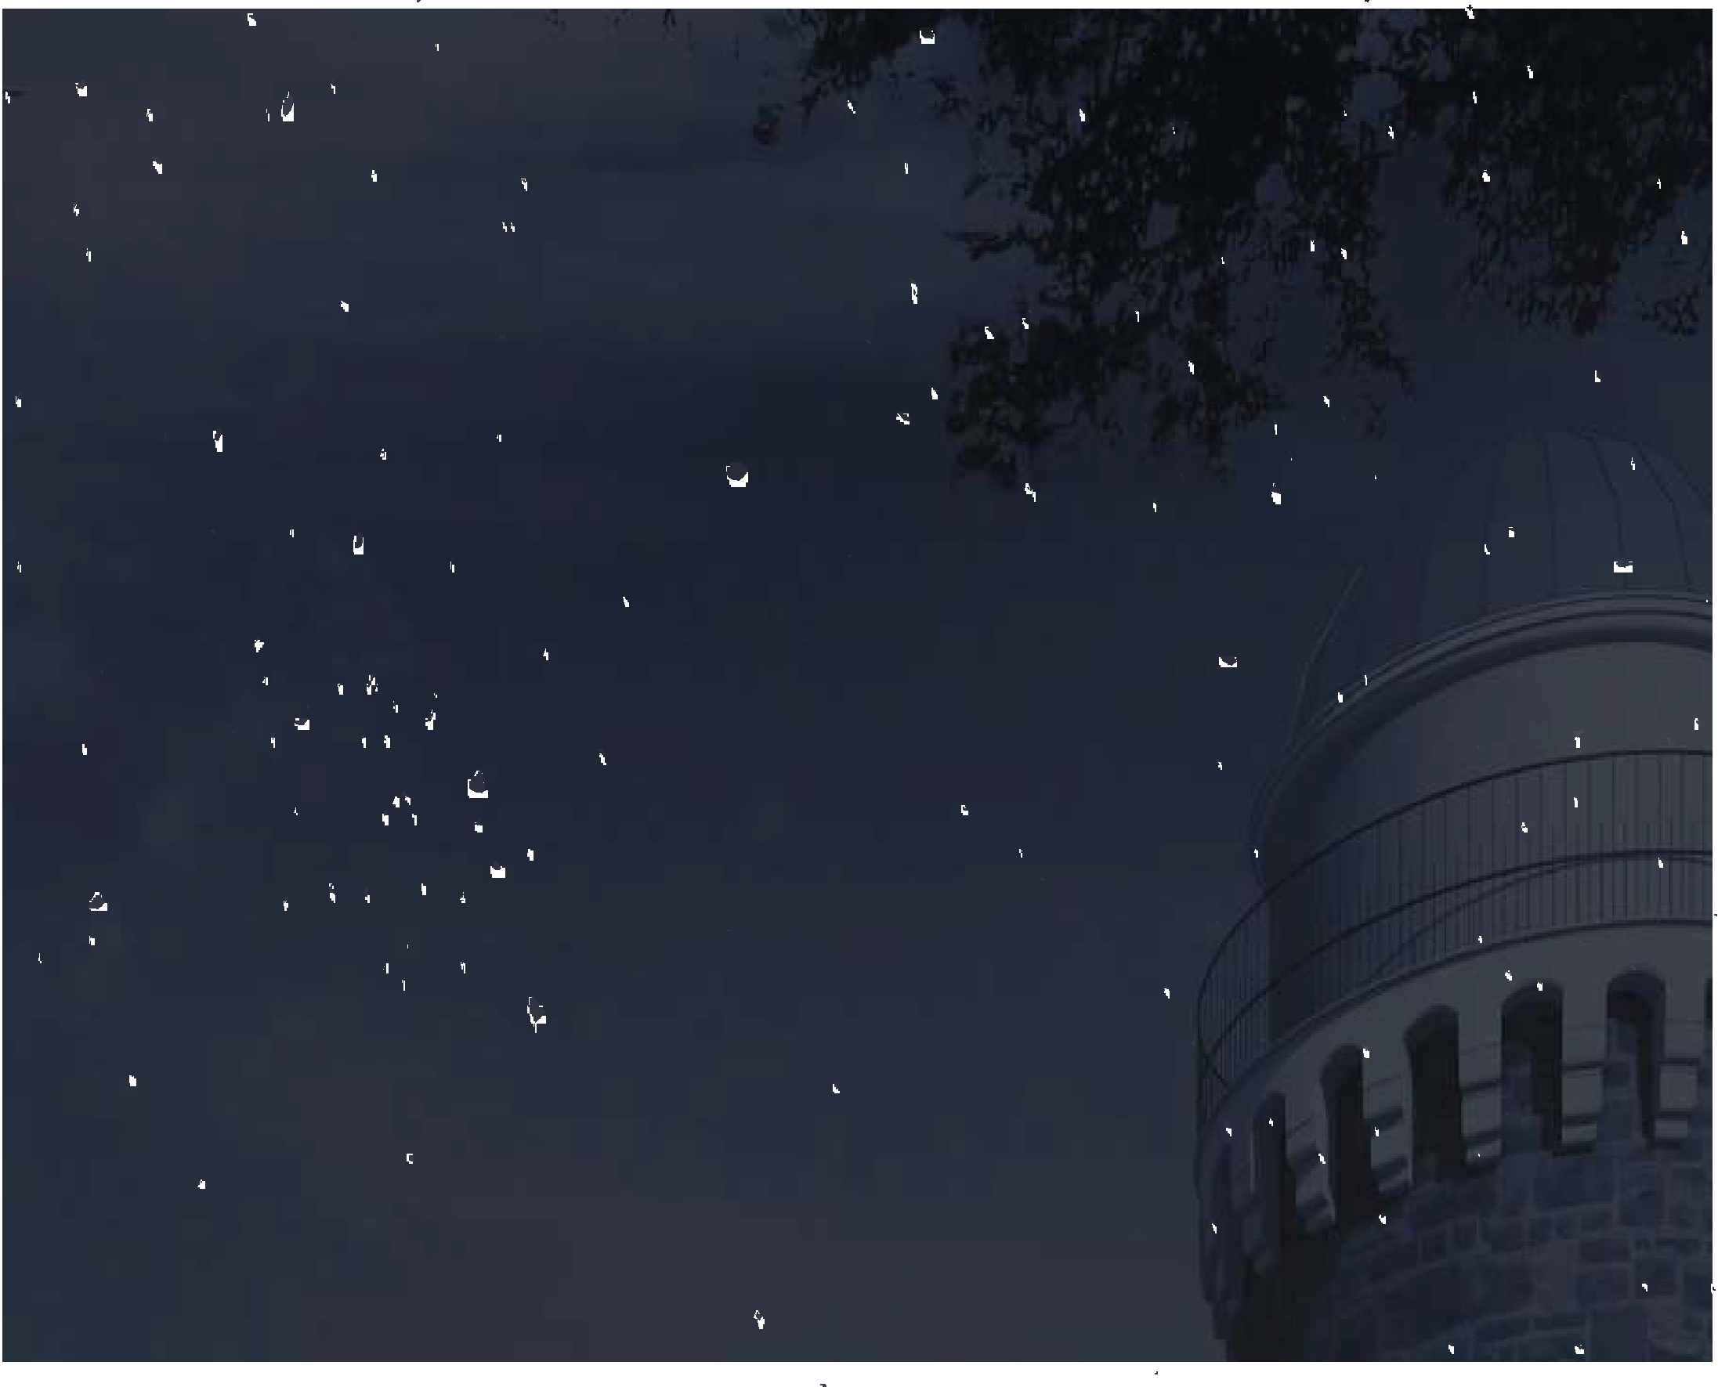
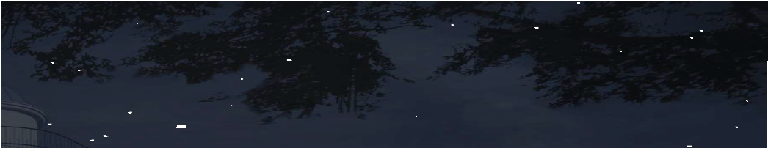













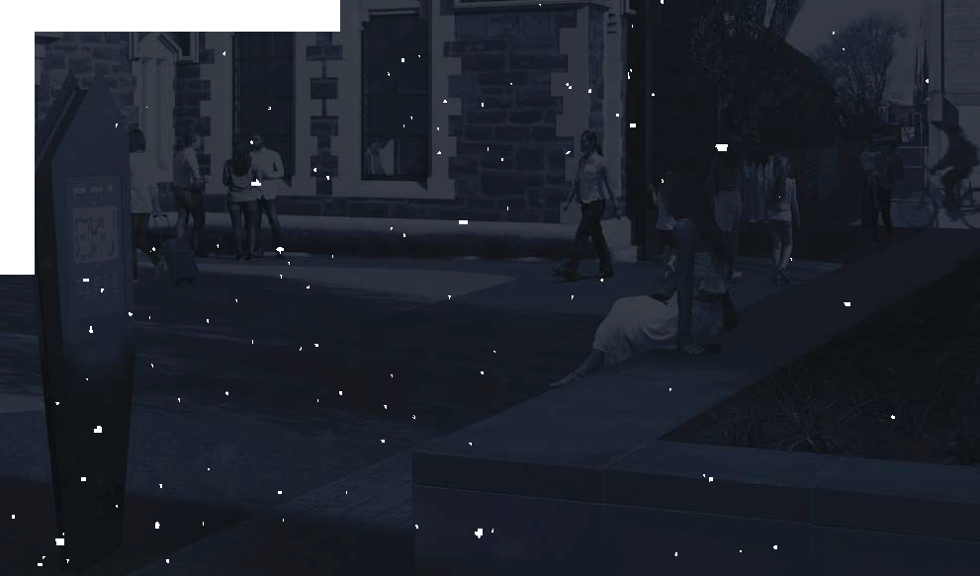

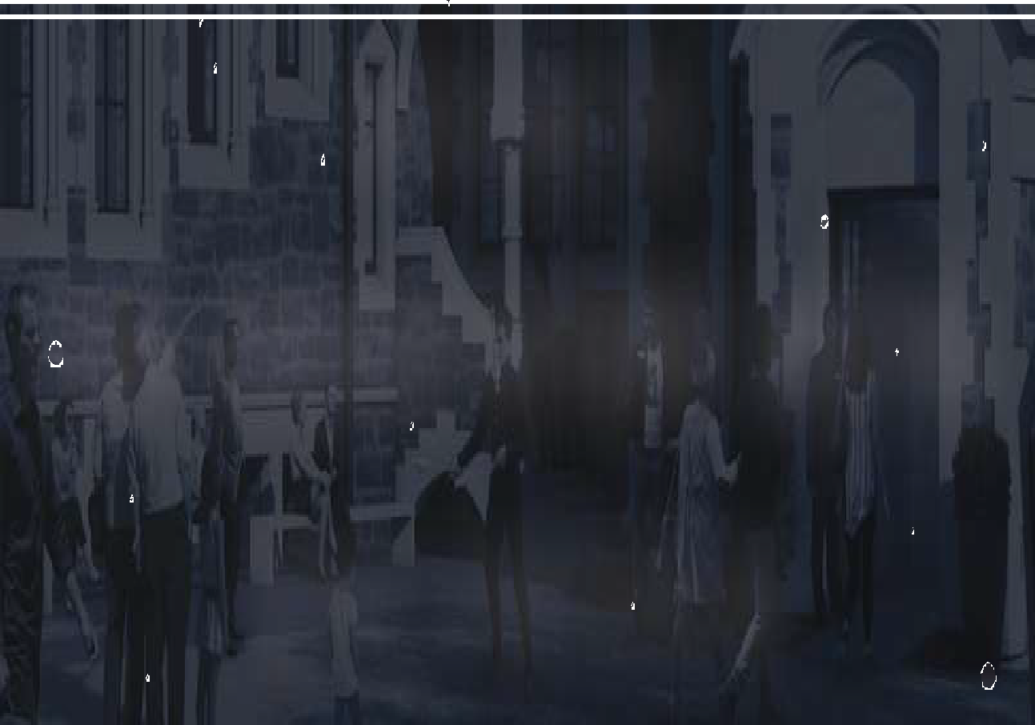








W E L C O M E TO
T H E O B S E RVATORY H O T E L
Tena Koe and a very warm welcome to The Observatory Hotel where we are taking you through a unique journey at a location that is listed by Heritage New Zealand with an outstanding historical significance.
We understand that is the little things that matter. We are at your service to complement your journey with unique and personalised services. Please feel free to contact us anytime where we will be happy to assist you to ensure you have a pleasant and memorable stay with us.
Warmest Regards,
The Observatory Team

Slide 2
KEY HOTEL INFORMATION
Baggage Storage
You are welcome to store your luggage with Guest Services at any time. Please notify our team and you may leave it in your room or bring it to our reception and we can store it in our secure luggage facilities.
Breakfast
Light continental breakfast is available between the hours of 6:30am - 10am at $25 per person. It is served at The Conservatory, located on level 3 of the hotel. Should you wish to have hot breakfast, Bunsen Café which is across the hotel opens for breakfast from 8am.
Car Hire
A full range of vehicles is available for hire from leading national and international rental car companies. We are more than happy to make rental car enquiries & arrangements on your behalf.
Check Out
Our check out time is 10:00am. If a later check out time is required, please contact reception, as an additional surcharge may be required. If unavailable, you are welcome to store your luggage with Guest Services.
Concierge Service
We have a knowledgeable concierge team to help you with any queries you may have whilst staying with us. We also have a helpful area at our reception, with informative brochures about Canterbury activities and attractions. Please ask our team for further details.
Dining Chargeback Service
We are pleased to offer our guests the convenience to chargeback their outside restaurant dining to their hotel bill, which can be paid for directly to the hotel upon check out. Please get in contact with Guest Services to be advised which of our neighbouring restaurants are currently available to take advantage of our charge back offering.
Dry Cleaning
Dry Cleaning services are available, please use the bag provided in your wardrobe and fill out the form (pricing is listed). Please leave the bag outside your door prior to 7.00am to be collected by a staff member, or alternatively leave it with us on your way out for the day.
Please be advised that there is no dry-cleaning service on Sundays or New Zealand Public Holidays.
,

Slide 3
Earthquake
In the event of an earthquake, please seek safety under a table or in a doorframe. Do not attempt to exit the building. Remain in your place of safety until the shaking has stopped then proceed to the front lawn and follow staff instructions.
Electricity
New Zealand electricity operates at 240 volts. Adaptors for electrical appliances are available from Guest Services.
Fire Evacuation
In the event of a fire, please sound an alarm, (located near the elevator), call 111 to alert the fire service and evacuate the building immediately. Please use the stairs and under any circumstances do not use the lift. Our assembly area where you will meet our chief fire warden is situated in front of the hotel entrance.
Gym
Your room key will give you a full access to our gym, which has the latest workout equipment. It can be used at any time of the day or night and is reserved only for our guests. Our gym is located on the ground floor of The Observatory Hotel and is open 24/7.
Housekeeping
Daily housekeeping service is provided for all guests between the hours of 8:00am and 4:00pm. If you require your room to be serviced outside of these hours, please inform Guest Services as soon as possible and we will do our best to get your room serviced.
Internet Access
To access our complimentary Wi-Fi access, please go to our Observatory Hotel Wi-Fi network and proceed with the instructions that appear on your screen. You will then be prompted to enter the below network password to access the highspeed Wi-Fi network.
Network: ObservatoryGuest
Password: observatoryhotel
Iron & Ironing Boards
Irons and ironing boards are located in the wardrobe of your room. If you require any assistance, please contact Guest Services.
,

Slide 4
Linen & Towels
Housekeeping can provide extra towels or amenities if necessary. To arrange this, please notify Guest Services on “0”. The Observatory Hotel practices Eco- Friendly procedures. If your towels are hanging in the bathroom, we will leave them for you to reuse. If you wish to have them replaced, please leave them on the floor or in the shower.
Maintenance
If you have any problems with your room, appliances or equipment, please dial Guest Services on ‘0’ and we will do our best to amend the situation immediately.
Massage
Within The Arts Centre precinct, a short walk away from The Observatory Hotel, is Dee Dee Thai Massage. They are open from 9:00am to 6:30pm, 7 days a week. Advanced bookings are preferred and can be done so at +64 21 053 9253. Our team at Guest Services can also book this in for you.
Meeting Room
Designed to cultivate creativity, our meeting room seats up to 8 people. The room provides a flexible space for board meetings, planning sessions, workshops and everything in between. Equipping you with a premium suite of tools and features, our meeting room is complete with all the equipment and amenities to fulfill your individualised requirements. Catering is available upon request.
Minibar
Minibar items are available to order upon request from Guest Services at any time during your stay. We have placed our full Minibar menu within your room for your convenience.
Pillow Menu
The Observatory Hotel is pleased to offer our guests with a range of pillows on our hand-picked pillow menu to ensure you have a pleasant night’s sleep. We currently offer the following pillows to choose from:
- Memory Foam Pillow
- Lavender Pillow
- Symphony Pillow
- Hypoallergenic Pillow
Please contact Guest Services to request for one of the above.
,

Slide 5
Safe Deposit Box
All rooms are equipped with a security safe for your valuables. Follow the instructions located on the safe before placing your personal belongings inside.
Smoking
The Observatory Hotel has a non-smoking and non-vaping policy inside all guest rooms & public areas. This also includes the entire Arts Centre precinct. A fixed fee of $400 per day will be added to your account if you are found to be smoking inside your guest room, plus any additional expenses we incur due to this activity.
The Drawing Room (coming soon)
Unwind and socialize at our Drawing Room with a range of carefully selected wines to tease your palates, accompanied with a selection of snacks. Opens every evening for pre-dinner drinks from 6:00pm till 8:00pm.
The Conservatory
A cosy and comfortable room tucked neatly on level 3 where you can enjoy the spectacular view of the Art Centre while having a light Continental breakfast from 7:00am till 10:00am.
Taxis & Private Airport Transfers
Private airport transfers are available at an additional cost. Please contact Guest Services on ‘0’ with your flight details for us to book this service for you or if you would like us to call a taxi instead, at any point during your stay.
Telephone Dialling Instructions
Outside line – dial “1” then the phone number you are calling to
Guest Services – dial “0”. Room to Room – dial “7” then dial the room number directly. International – dial “1” followed by “00”, country code, area code and number you are calling.
Tours
There are many different types of tours that you can experience here in Christchurch but also in the wider Canterbury region. If you are interested in a specific tour or would like to enquire about tours, please get in touch with Guest Services.
Useful Contacts
In-House Emergencies: Call Guest Services on ‘0’. For Police, Ambulance or Fire: 111
,

Slide 6
WINE & DINE OPTIONS
The Observatory Hotel is located in the heart of Christchurch City, providing you with easy access to the cities best dining facilities. There are a number of eating options available here in the Arts Centre itself and in the surrounding area.
Curators House
An exquisite sanctuary, originally built for the curator of the Botanic Gardens in 1920, now is home to an iconic restaurant located at the Botanical Gardens. Enjoy its authentic Spanish cuisine & friendly service at the terrace garden or in one of its charming dining rooms.
Bunsen
Bunsen burst into the culinary scene in November 2016 and quickly became a top destination for locals and tourists alike. The cafe specialises in the perfect cup of coffee served in a range of brew methods including syphon, aeropress, pour-over, cold-drip and espresso using its own blend, The Dark Horse.
Zen Sushi & Dumplings
Zen Sushi & Dumplings offers a unique combination of cold sushi and hot dumplings under one roof. Zen’s sushi is made by the best sushi chefs, who not only ensure their sushi tastes heavenly, but also pursue presentation perfection which is sure to please the eye. The chefs use the highest quality ingredients, such as free-range chicken, free-range eggs and Marlborough King Salmon.
.
Riverside Market
In the heart of the CBD, overlooking the Avon River, Riverside Market us a 7-day indoor farmers’ market selling local produce, meat, seafood, baked goods, coffee and more. Alongside the market is Riverside Lanes, a destination boutique shopping experience with major fashion brands.
Inati
At Inati you will dine around the chef’s table and share in the experience that is the theatre of the kitchen. Inati will offer seasonally-inspired tasting plates that will challenge the notion of what a traditional dining experience is. Utilising the finest produce sourced locally, to will showcase the best of Canterbury.
Christchurch Tramway Restaurant
New Zealand’s only restaurant tramcar, we offer you a unique way to view the inner city of Christchurch while enjoying a delicious evening dinner.
Experience the luxury of our 36 seater air-conditioned, heritage dining tram and be treated to premium local cuisine and beverages along with attentive and friendly service.
Frances Nation Grocer
Frances Nation Grocer is renowned for its coffee and lunch options at Te Matatiki Toi Ora The Arts Centre. The Grocer stocks freshly baked bread and a wide range of locally produced pantry items: cheese, eggs, honey, jams, bottled fruits, flour, vinegar, olive oil and more. There are plenty of picnic-ready options for those wishing to enjoy the natural scenery provided by the Botanic Gardens.
Cellar Door
Cellar Door offers comparative wine tasting flights and an extensive selection of local and international wines by the glass and bottle. It also offers a collection of library wines from New Zealand and around the world, along with craft beer, cocktails and spirits. The fresh seasonal food menu is matched to complement its wine list.
Fiddlesticks Restaurant & Bar
Sociable and relaxed, Fiddlesticks Restaurant & Bar is Christchurch’s most sophisticated retreat. Fiddlesticks offers an inviting atmosphere in which to while away some time in the heart of the Arts Precinct. Watch the street side activity while soaking up the ambience in front of a roaring outdoor fire in our sheltered courtyard, or join friends in one of the intimate dining spaces.
,

Slide 7
ACTIVITIES
Christchurch is a city like no other, offering the best outdoor pursuits and activities such as skiing, golfing, hunting, fishing, tramping and mountain biking just in our backyard. Bordered by the Port Hills, the Canterbury plains, the Pacific Ocean and the Southern Alps, Christchurch is host to an abundance of wildlife and unique flora, offering spectacular scenery as well as the comforts of the city life.
In February 2011, Christchurch experienced a devastating earthquake that rocked the central city. Since then, Christchurch has emerged as one of New Zealand’s most resilient and innovative cities. It is an exciting time to visit as it is currently experiencing a renaissance of fresh ideas and renewed creativity.
Te Matatiki Toi Ora - The Christchurch Arts Centre, located in the heart of Ōtautahi Christchurch, The Arts Centre is an Aotearoa New Zealand landmark. Home to galleries, museums, cinemas, boutique retailers, artisan eateries and bars, engaging events, stunning venues and much more.
Hurunui Trails
The Waipara Vineyard Trail has been developed to encourage cycling and hiking in the Waipara Valley. Pass through world-class vineyards and historic farms; visit cellar doors and lunch at one of the
wineries along the way. The views across the valley to the Main Divide are truly remarkable. Trails are designed for cyclists, walkers, and joggers.
Akaroa
Akaroa is a French settled township with amazing food and beautiful scenery, perfect for a day away from the city. The small township offers some once in a lifetime opportunities such as swimming with wild dolphins and the very special cooking school using local ingredients from sea and land. With many scenic walks and things to see in Akaroa there is no chance of a boring day. Take in the relaxing sea air, shop in some unique boutique shops; experience New Zealand with a French twist!
Christchurch Botanical Gardens
Christchurch is known as the Garden City, what better way to experience the reason behind this name then seeing it for yourself. The area is a 2-minute walk from the Arts Centre. The Botanical Gardens is connected to Hagley Park making it the biggest, open, green space in Christchurch allowing you to feel like you are away from the city when in fact you are directly in the middle. Enter the green houses and see exotic flowers and plants, take a walk through the bush and just relax, stop for a drink or something to eat in the cafe or continue the relaxation by entering the Canterbury Museum and take a step back in time.
Farmers Markets
Christchurch is full of the freshest and highest quality produce and products and the best place to find these are at local farmers markets, which occur all over the city in many different areas. Farmers markets bring together small local businesses and farmers that supply their community with fresh produce week after week. Many of the markets occur over the weekend and can be found in all corners of the city. Ask reception if you are interested in visiting a market and they can point you in the right direction.
Up & Coming Events In Christchurch
Post Earthquake Christchurch is full of rebuilding and hype for new activities and events that will brighten the city and once again make it the beautiful Garden City.
Check out www.bethere.co.nz for information on events and many more, happening in Christchurch and the Canterbury area.
If you require more information or would like some assistance on these events & activities, or any others, our Guest Services team share local knowledge and would be happy to assist you with your plans. Local maps and activity brochures are also available from reception.
,

